Slide 1
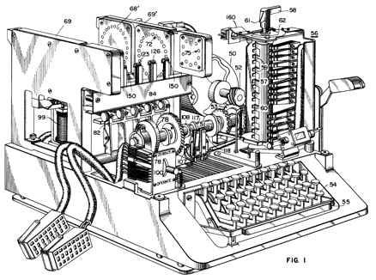
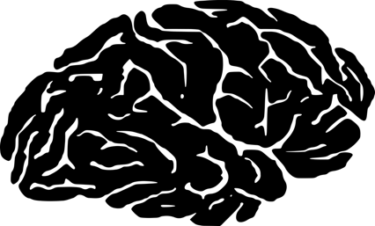
Minds and machines
https://djnavarro.github.io/minds-machines-4103/
Danielle Navarro
d.navarro@unsw.edu.au

Slide 2
Structure to the class
Content
See homepage!
Assessment
See homepage!
Tips on presenting & participating?
Oh gosh… um… see homepage! ☺

Slide 3
Structure for today
Introductory comments
Let’s talk… does psychology have theory?
Background to computational modelling
Getting started with R
Download and install
Work through the introductory sections of the notes at https://psyr.org

Slide 4
A temporary measure
This is for my other R class, and I’m currently putting together a clean one for this class but the other one will be sufficient for today
Type this in RStudio:
install.packages("usethis")
usethis::use_course("psyr.org/part1_core.zip")

Slide 5
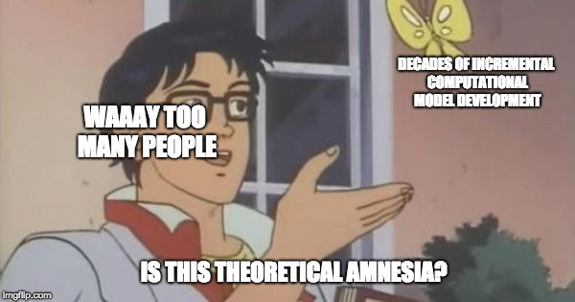

Slide 6

How should we think about cognition?
?

Slide 7
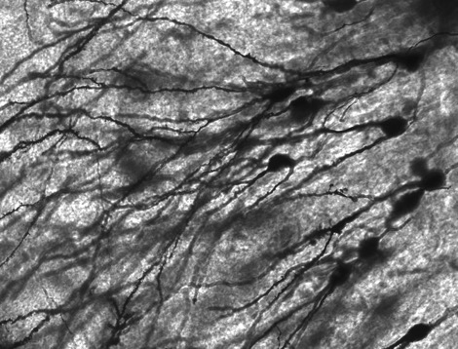
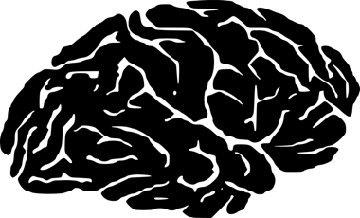
The view from “below”
Cognition is performed by the brain, and our theories of cognition should informed by the biology of the brain

Slide 8
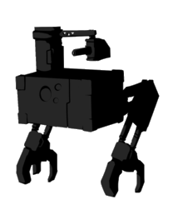


The view from “above”
Cognition is a feature of intelligent agents, and our theories of cognition should be informed by understanding what intelligent agents do

Slide 9

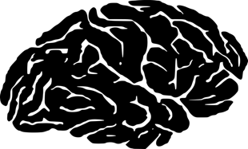
There are commonalities
At an abstract level, cognition is a form of computation, and the brain does information processing

Slide 10
But there are differences
What mechanisms does the brain use to perform computations?
What computational problems does the mind address?

Slide 11

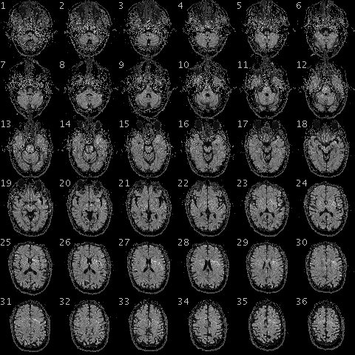
Brains perform computations using a network of neurons

Slide 12
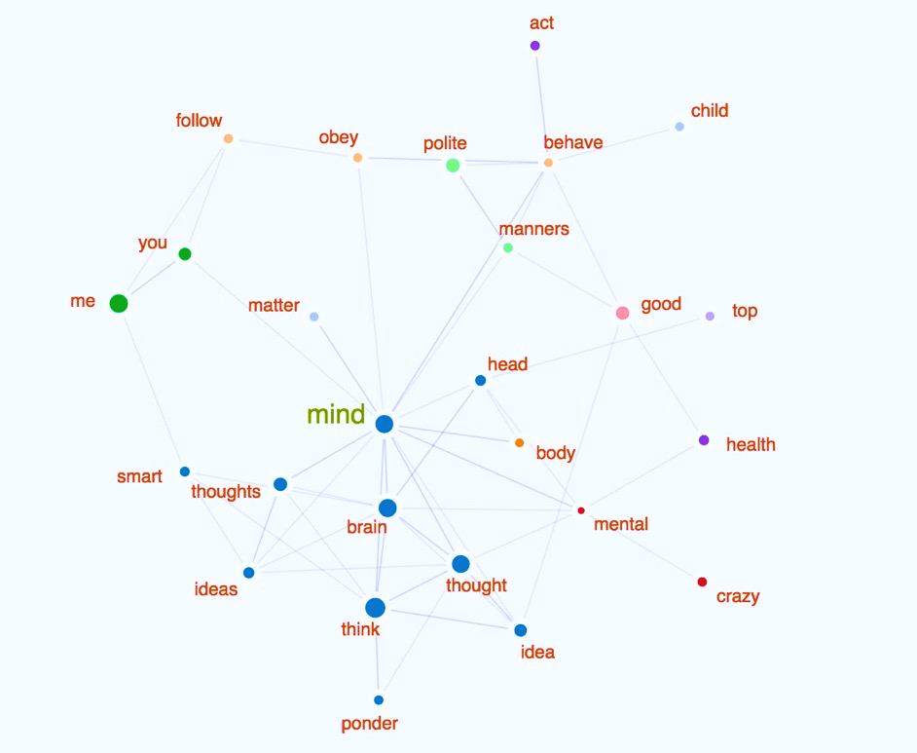
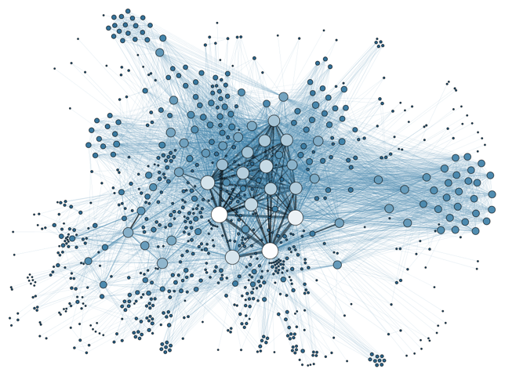
http://www.smallworldofwords.com/new/visualize
Minds encode meanings using a system of interrelated concepts

Slide 13
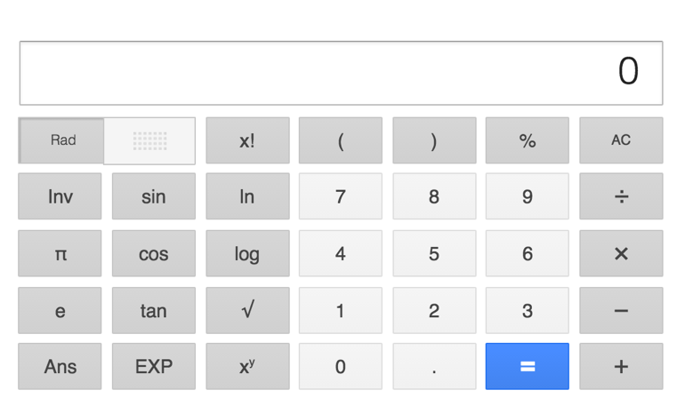
Levels of analysis
(Marr 1980)
Abstract computation: What problem does a system solve?
Algorithm: What processing steps does it follow to do so?
Implementation: How is this instantiated as a physical entity?

Slide 14
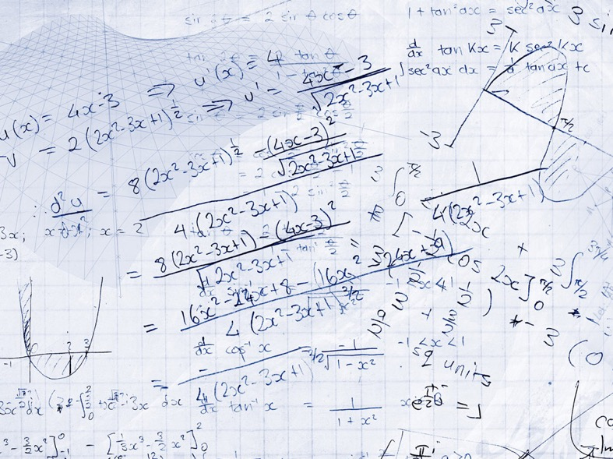

The computational level
“The function of a calculator is to solve arithmetic problems”

Slide 15

The algorithmic level
“Addition can be described using a computer program”

Slide 16
The implementation level
“A calculator uses circuitry to do calculations”

Slide 17
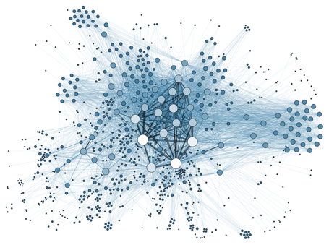

Computation
Algorithm
Implementation

Slide 18
The computationalist’s dream
“Because these regularities reflect universal principles … natural selection may favor their increasingly close approximation in sentient organisms wherever they evolve ... Possibly, behind the diverse behaviors of humans and animals, as behind the various motions of planets and stars, we may discern the operation of universal laws”
- Roger Shepard, 1987

Slide 19
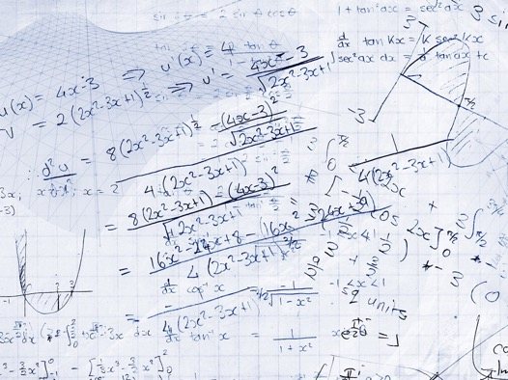

It’s a remarkable claim
The structure of the learning problem…
… shapes the structure of the mind that solves it?

Slide 20
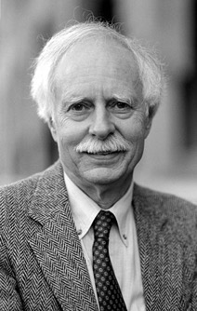
Case study: Shepard’s “universal law of generalisation”

Slide 21
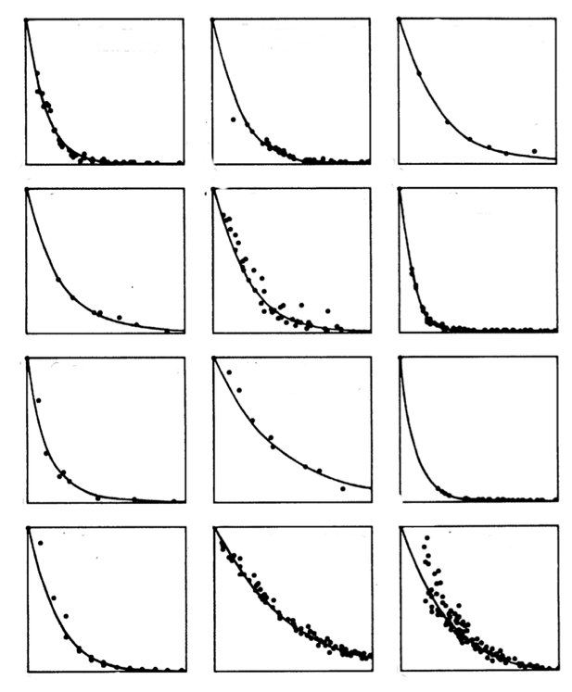


An invariance?
Invariance across stimulus types
“Generalisation”
Invariance across sensory modalities
d
p
g
θ
ŋ
t
Invariance across species
“Psychological distance”

Slide 22
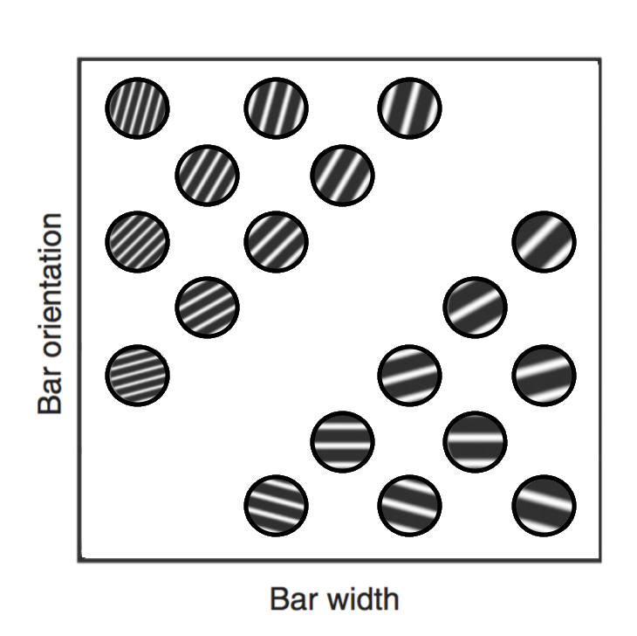
Psychological distance
Stimuli differing on one or more perceptual dimensions

Slide 23
Distant things are dissimilar
Nearby things are similar

Slide 24
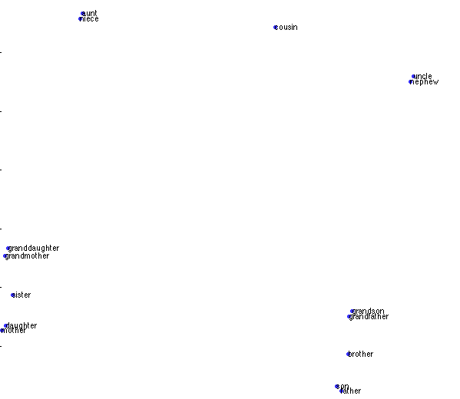
aunt
niece
cousin
uncle
nephew
grandmother
granddaughter
sister
grandson
daughter
grandfather
mother
brother
son
father

Slide 25
olive
coconut
date
strawberry
peach
apple
pineapple
pear
plum
lemon
FRUIT
orange
blueberry
banana
grapes
apricot
grapefruit
pomegranate
watermelon
honeydew
tomato

Slide 26
Measurement methods?
Confusability: probability of mistaking A for B
Reaction time: time taken to distinguish A from B
Forced choice: is X more like A or more like B?
Likert scales: how similar is A to B?
Sorting tasks: arrange objects into groups

Slide 27






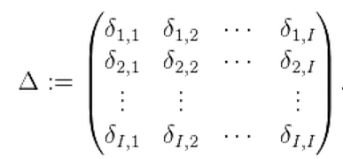
Empirical data…
Distance matrix Δ where δi,j is the distance between objects i and j
 | 0 | 1 | 2 | 4 | 5 | 6
 | 1 | 0 | 1 | 3 | 4 | 6
 | 2 | 1 | 0 | 1 | 3 | 4
 | 4 | 3 | 1 | 0 | 2 | 3
 | 5 | 4 | 3 | 2 | 0 | 1
 | 6 | 6 | 4 | 3 | 1 | 0

Slide 28
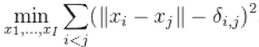
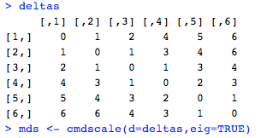
… blah blah blah …
Take this data and use it to work out where items are?
Use a technique called Multidimensional Scaling (MDS)
Basically uses numerical optimisation to find the points in a k-dimensional space that preserves the distances as well as possible - i.e., that minimises a function like the following
In R:
cmdscale(d,eigs=TRUE)
distance matrix
returns eigenvalues for each dimension

Slide 29
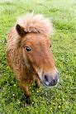
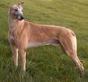
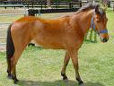
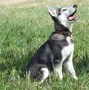


… a psychological space capturing people’s intuitions about similarity

Slide 30
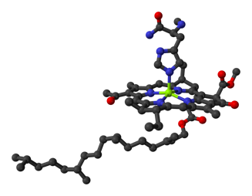
Inductive generalisation
This animal produces TH4 enzyme

Slide 31
Inductive generalisation
This animal produces TH4 enzyme
Does this one?

Slide 32
Inductive generalisation
This animal produces TH4 enzyme
What about this one?

Slide 33






More similarity…
… produces more generalisation.
Obviously. But...

Slide 34
The shape is always the same. Why is the shape always the same?
“Generalisation”
“Psychological distance”

Slide 35
It’s not an inevitability?
This is what you’d expect if people were setting a “hard and fast” boundary
This is what you’d expect on average if people were responding randomly
This is pretty weird, but it you can get this if people are doing something sensible that is only loosely related to similarity

Slide 36
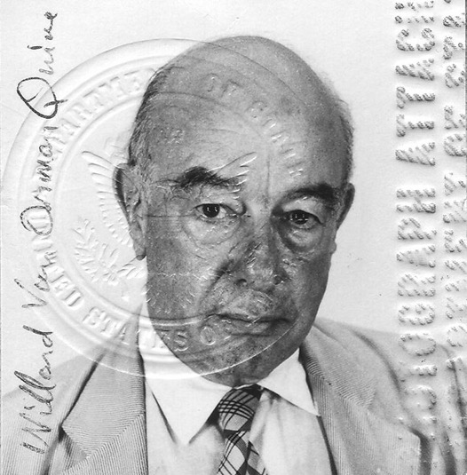
Why similarity matters
“Similarity, is fundamental for learning, knowledge and thought, for only our sense of similarity allows us to order things into kinds so that these can function as stimulus meanings. Reasonable expectation depends on the similarity of circumstances and on our tendency to expect that similar causes will have similar effects”
- Willard Van Orman Quine,1969

Slide 37
Why similarity matters
“We generalize from one situation to another not because we cannot tell the difference between the two situations but because we judge that they are likely to belong to a set of situations having the same consequence”
- Roger Shepard, 1987

Slide 38
Why similarity matters
“An object that is significant for an individual … is always a member of a particular class ... Such a class corresponds to some region in the individual’s psychological space, which I call a consequential region. I suggest that the psychophysical function that maps physical parameter space into a species psychological space has been shaped ... so that consequential regions are not consistently elongated or flattened in particular dimensions”

Slide 39
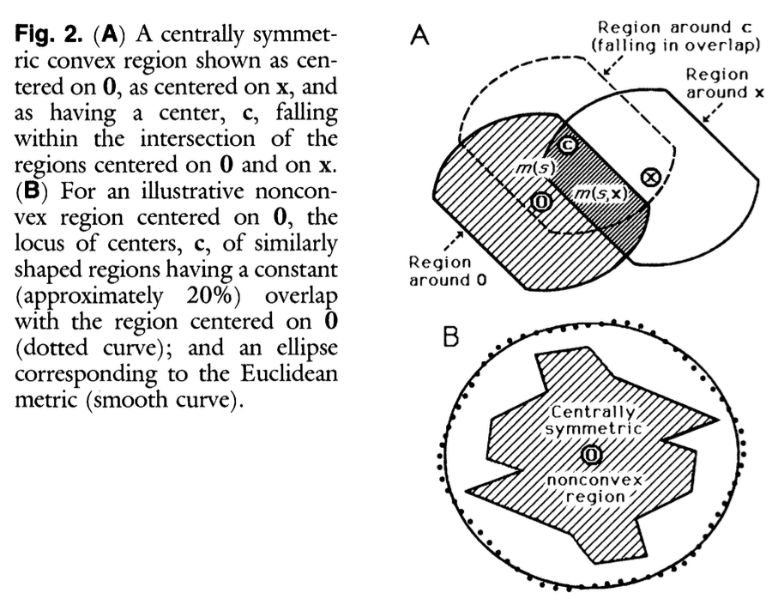
Why similarity matters

Slide 40

Let’s follow Shepard’s reasoning…
(Maths warning – this part has equations. Ignore them and focus on the ideas)

Slide 41






One possible consequential region consistent with the data

Slide 42
But there are many!

Slide 43
The probability that a new item x shares the property depends on the probability that a consequential region includes that point
x

Slide 44
Lots of overlap
Not so much

Slide 45
For some single consequential region of size s, the conditional probability that x is contained in the region is just the ratio m(s,x)/m(s) of the measure of the overlap to the measure of the whole such region
m(s,x)
m(s)

Slide 46
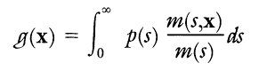
We calculate the probability that x is contained in any arbitrary region by integrating over all possible regions
g(x) = probability that a response learned to stimulus 0 will generalise to x
m(s,x)
m(s)

Slide 47
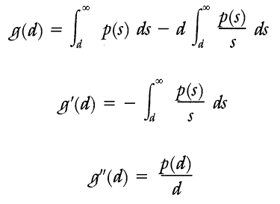
We calculate the probability that x is contained in any arbitrary region by integrating over all possible regions
g(x) = probability that a response learned to stimulus 0 will generalise to x
Then we find that generalisation is a function of the distance d in the psychological space that…
Has unit value at d=0
Monotonically decreases with increasing d
Is concave upward (mostly)

Slide 48
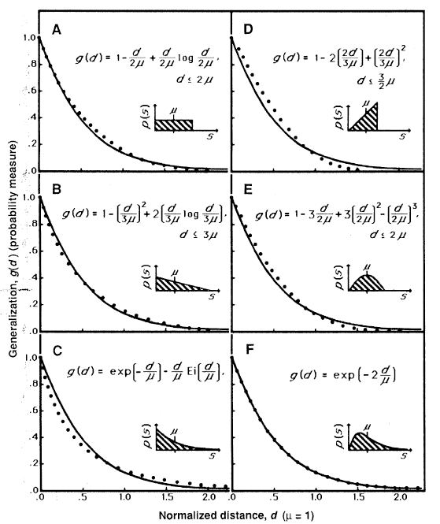
Shape of the generalisation gradient?
That depends on the nature of p(s) …

Slide 49
Shape of the generalisation gradient?
That depends on the nature of p(s) …
… but not very much

Slide 50
So why do we see this invariance?
Invariance across stimulus types
“Generalisation”
Invariance across sensory modalities
d
p
g
θ
ŋ
t
Invariance across species
“Psychological distance”

Slide 51

Structure of the problem!
“Generalisation”
“Psychological distance”

Slide 52
Structure of the problem!

Slide 53
Are there other examples?

Slide 54
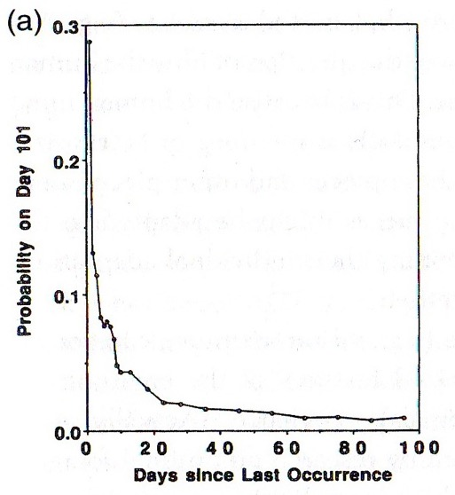
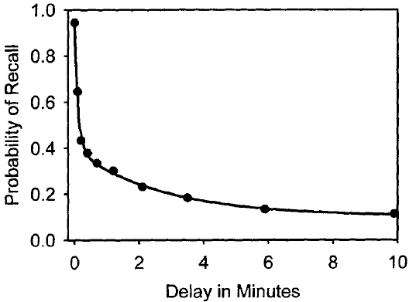
Memory?
environment
memory
The probability that people recall a particular piece of information is closely matched to the probability that it is needed by the person. (Anderson & Schooler, 1991)

Slide 55
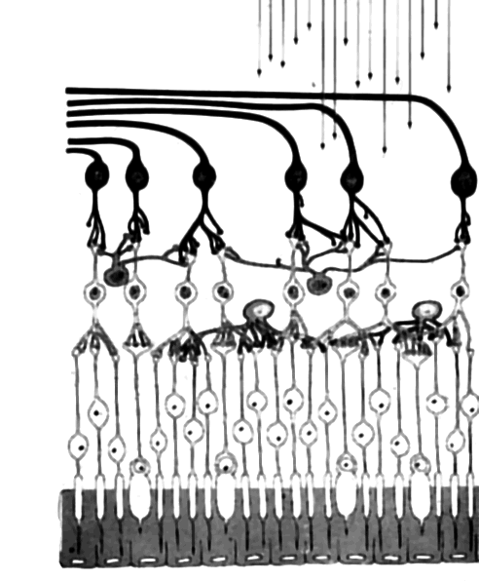
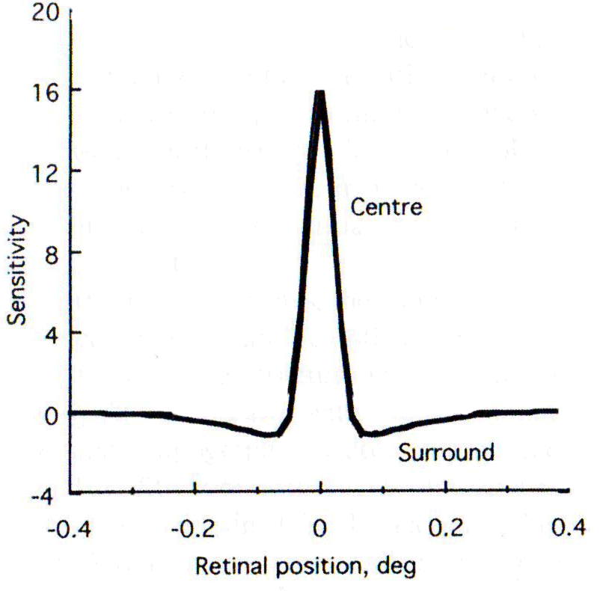
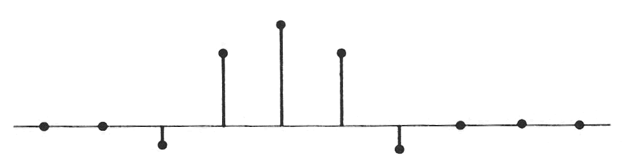


Vision?
Centre-surround receptive fields have a mirror in optimal signal processing…
… because high pass filters are good for edge detection?

Slide 56


Slide 57
“Bonus lecture”
Introduction to Bayes

Slide 58
Structure
What does the word “probability” mean?
What are the rules that probabilities obey?
Discovering Bayes’ rule
What is Bayes’ rule used for?
An example of Bayesian reasoning

Slide 59
What does the word “probability” mean?

Slide 60
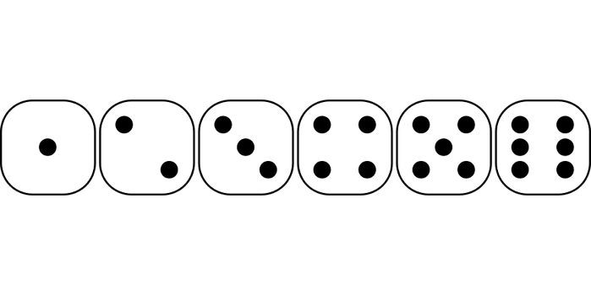


“Aleatory” processes
Probability is an objective characteristic associated with physical processes, defined by counting the relative frequencies of different kinds of events when that process is invoked

Slide 61
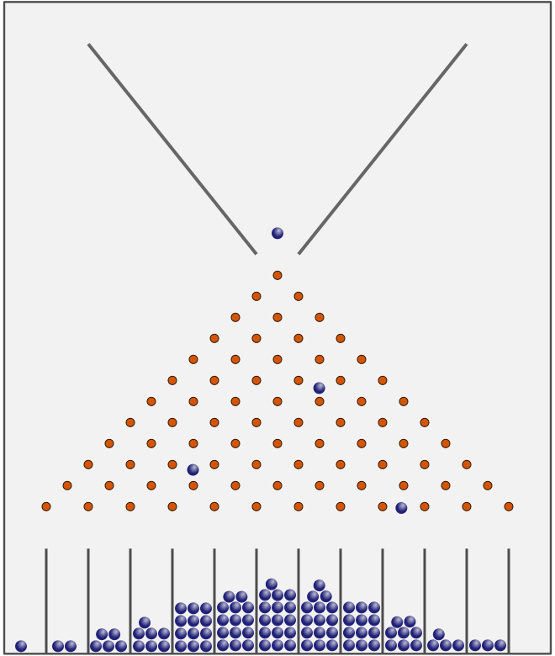
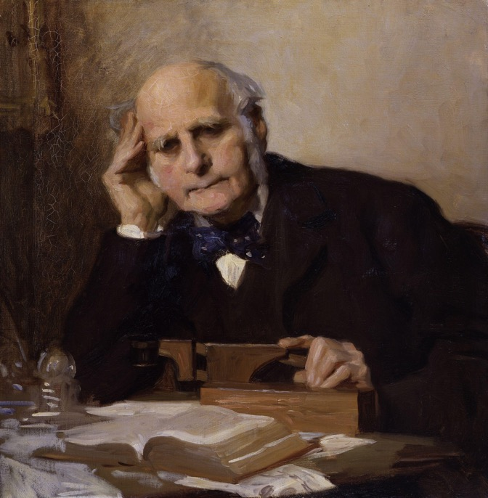
“Aleatory” processes

Slide 62
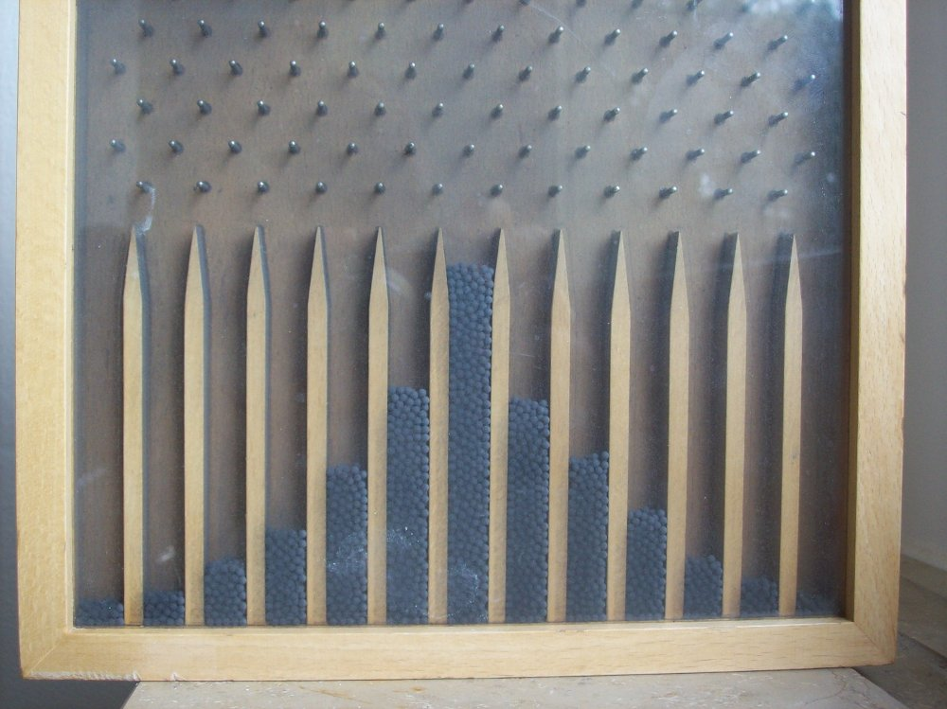

Slide 63
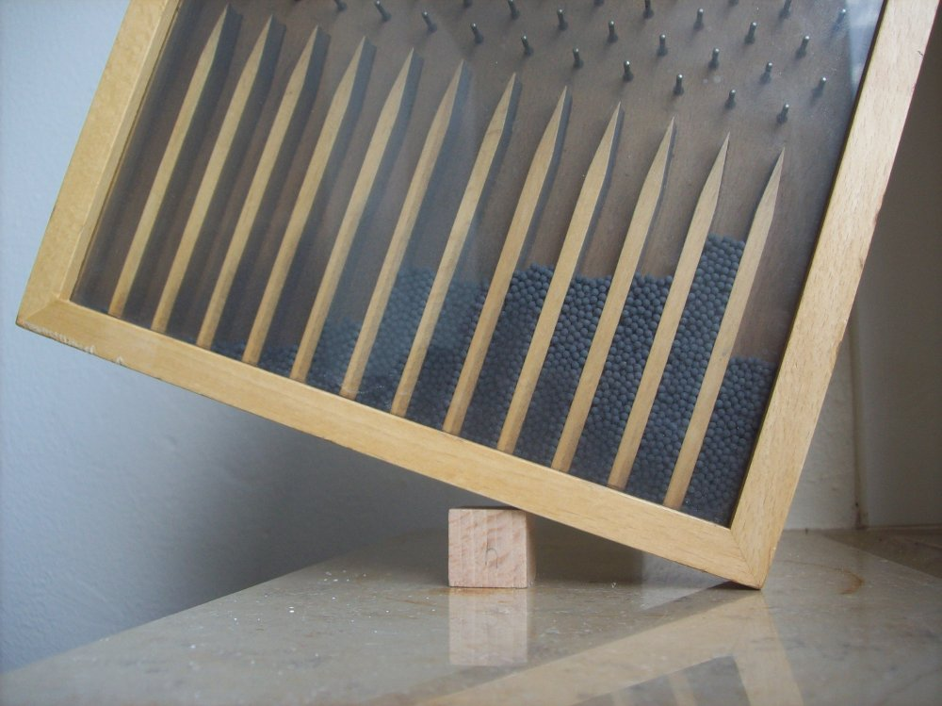

Slide 64
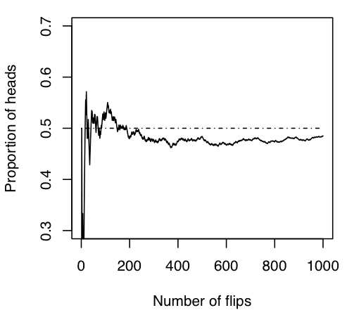
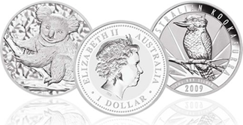
Frequentist statistics
Coin flipping is an aleatory process, and can be repeated as many times as you like
The probability of a head is defined as the long-run frequency

Slide 65
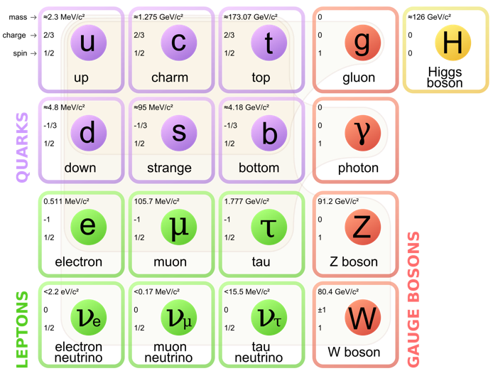
Frequentist statistics
A particle physics experiment is a repeatable procedure, and thus a frequentist probability can be constructed to describe its outcomes
A scientific theory is not a repeatable procedure, and cannot be assigned a probability: there is no such thing as “the probability that my theory is true”

Slide 66



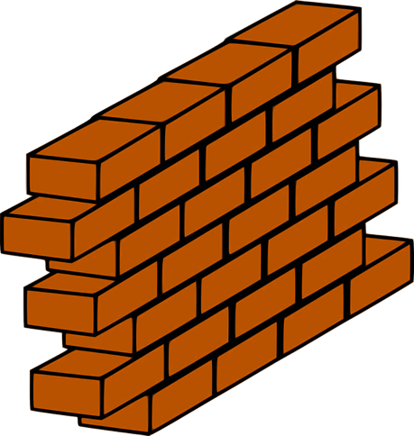
Epistemic uncertainty
Probability is an subjective characteristic associated with rational agents, defined by assessing the strength of belief that the agent holds in different propositions
?
?
?
?

Slide 67

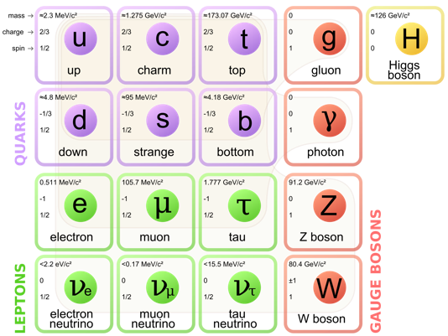
“Bayesian” statistics
Probabilities can be attached to any proposition that an agent can believe
A particle physics experiment generates observable events about which a rational agent might hold beliefs
A scientific theory contains a set of propositions about which a rational agent might hold beliefs

Slide 68
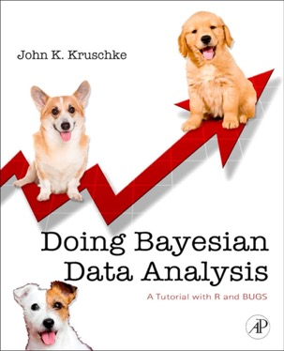
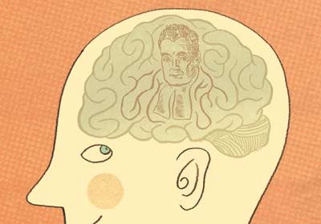
Two different ways to use this idea
“Psychologists should use Bayesian statistics to analyse data”
“Human reasoning can be described as a form of Bayesian inference”

Slide 69
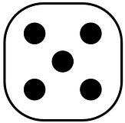

How probabilities behave
(note: Bayesians and frequentists agree on these rules)

Slide 70






Thirty six cases in total

Slide 71
Three cases where the dice add up to 4

Slide 72






All 36 cases organised by outcome
The three cases where the result adds up to 4

Slide 73
Roll | 2 | 3 | 4 | 5 | 6 | 7 | 8 | 9 | 10 | 11 | 12
N | 1 | 2 | 3 | 4 | 5 | 6 | 5 | 4 | 3 | 2 | 1

Slide 74
Probabilities are numbers between 0 and 1
Probability = 0 means “impossible”
Probability = 1 means “certain”
Roll | 2 | 3 | 4 | 5 | 6 | 7 | 8 | 9 | 10 | 11 | 12
N | 1 | 2 | 3 | 4 | 5 | 6 | 5 | 4 | 3 | 2 | 1
Prob | .028 | .056 | .083 | .111 | .139 | .167 | .139 | .111 | .083 | .056 | .028
Probability = 3/36 = .083

Slide 75
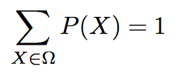
Probabilities sum to 1
“Law of total probability”
“Conservation of belief”
Roll | 2 | 3 | 4 | 5 | 6 | 7 | 8 | 9 | 10 | 11 | 12
N | 1 | 2 | 3 | 4 | 5 | 6 | 5 | 4 | 3 | 2 | 1
Prob | .028 | .056 | .083 | .111 | .139 | .167 | .139 | .111 | .083 | .056 | .028
.028 + .056 + .083 + .111 + .139 + .167 + .139 + .111 + .083 + .056 + .028 = 1

Slide 76
“not A” means “something other than A happens”
NOT
The probability of “not rolling a four” equals one minus the probability of rolling a four

Slide 77
A = “at least one die has a value of 2”

Slide 78
B = “the total is at least six”

Slide 79
A = “at least one die has value 2”
B = “the total is at least six”
AND
The joint probability that “A and B” both occur

Slide 80
A = “at least one die has value 2”
B = “the total is at least six”
OR
The probability that at least one of A or B occurs

Slide 81
A = “at least one die has value 2”
B = “the total is at least six”
IF
The conditional probability that B occurs given that A occurs

Slide 82
AND
IF
6/36
11/36
6/11

Slide 83
OR
AND
31/36
6/36
11/36
26/36

Slide 84
Discovering Bayes’ rule

Slide 85
Exchangeability – when the order doesn’t matter
6/36
11/36
6/11

Slide 86
Exchangeability – when the order doesn’t matter
6/36
26/36
6/26

Slide 87
So if...
… and ...
Then ...

Slide 88
So if...
… and ...
Then ...
And if ...
Then ...

Slide 89
Bayes’ rule

Slide 90
= 26/36
Probability that the total is at least 6

Slide 91
= 6/26
= 26/36
Probability that the total is at least 6
Probability that at least one die has a 2 given that the total is at least 6

Slide 92
= 6/26
= 26/36
Probability that the total is at least 6
Probability that at least one die has a 2 given that the total is at least 6
Probability that at least one die has a 2
= 11/36

Slide 93
= 6/26
= 26/36
Probability that the total is at least 6
Probability that at least one die has a 2 given that the total is at least 6
Probability that the total is at least 6 given that at least one die has a 2
Probability that at least one die has a 2
= 6/11
= 11/36

Slide 94
What is Bayes’ rule used for?

Slide 95
Bayes’ rule is a mathematical fact that probabilities must obey
26/36
6/26
6/11
11/36

Slide 96
Bayesian reasoning happens when we combine this mathematical rule with epistemic probability

Slide 97

What do we use this for??
h = A hypothesis about the world
d = Some observable data

Slide 98
How strongly should I believe in this hypothesis…
… given that I have observed these data?

Slide 99

h|d
The posterior probability that my hypothesis is true given that I have observed these data…

Slide 100
h
The prior probability that I assigned to this hypothesis before observing the data

Slide 101
d|h
The likelihood that I would have observed these data if the hypothesis is true

Slide 102
d
The “marginal” probability of observing these particular data (more on this shortly)

Slide 103


Belief revision!
Prior beliefs
Posterior beliefs
Data

Slide 104

P(d|h) : the likelihood of observing d if h is true
P(h) : the prior probability that h is true
P(h|d) : the posterior probability that h is true
P(d) : discussed later

Slide 105
What happened here? An example of Bayesian reasoning

Slide 106
There are many possibilities
dropped a wine glass
broke a window
psychic explosion
etc…
earthquake
a wizard did it

Slide 107
Let’s just think about two of them
I dropped a wine glass
Kids broke the window

Slide 108


“Prior odds”
=
= 0.1
Before learning anything else I think “wine glass dropping” is 10 times more plausible than “broken window”

Slide 109
Some data
There is a cricket ball next to the broken glass

Slide 110
Likelihood of the data
When I drop a wine glass…
… It’s very unlikely that I just happen to do so right next to a cricket ball
P(d|h) = 0.001

Slide 111
Likelihood of the data
When the kids break a window…
… It’s not at all uncommon for a cricket ball to end up near the glass
P(d|h) = 0.15

Slide 112


“Likelihood ratio”
(a.k.a. Bayes factor)
0.15
=
=
= 150
0.001
I think it is 150 times more likely that I would find a cricket ball when a window breaks than when a wine glass is broken

Slide 113
Posterior odds
Posterior odds
Likelihood ratio
Prior odds
= 15
= 150
= .1
In light of the evidence, I now think the window-breaking hypothesis is 15 times more likely than the wine-glass hypothesis

Slide 114




The learner has a hypothesis space
…

Slide 115
Priors assign probabilities P(h)
0.01
0.01
0.01
0.80
0.08
…

Slide 116
Each hypothesis provides a likelihood P(d|h)
0.5
0.03
0.001
…

Slide 117
Posteriors computed by Bayes’ rule

Slide 118

Posteriors computed by Bayes’ rule
Sum taken across all possible hypotheses

Slide 119
The question…
Bayesian reasoning is a powerful tool for building intelligent robots…
… but is it a useful tool for helping us to understand human cognition?

